Slide 1
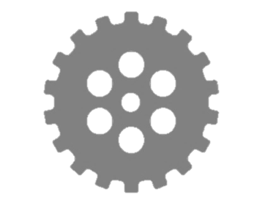

Additive Manufacturing
Short introduction to the technology
Part Build
CAD Design
Chemical
properties
CAD Translator
Build Process
CAD Model
Material
File
Verification
PART
Physical
properties
Preparation
Cleaning
Support remove
Orientation
Support
Post Process
Post curing
Parameters

Slide 2
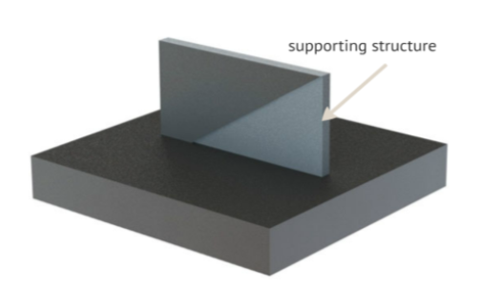
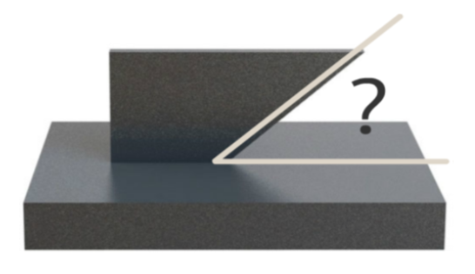
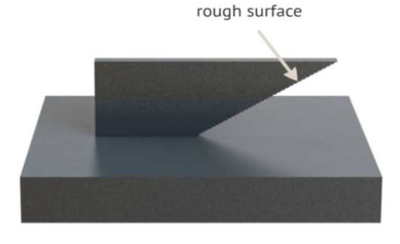
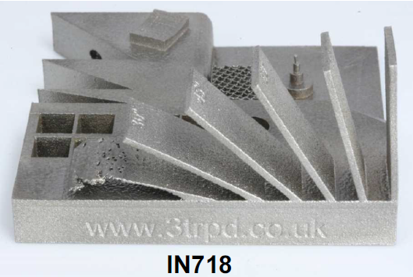
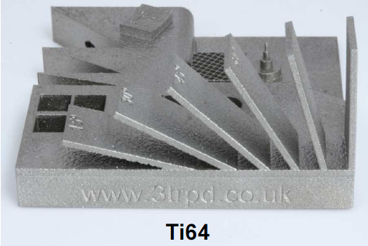
Additive Manufacturing
Short introduction to the technology
Angled surfaces

Slide 3
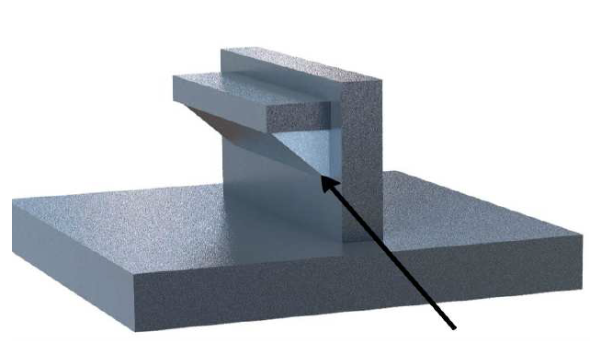
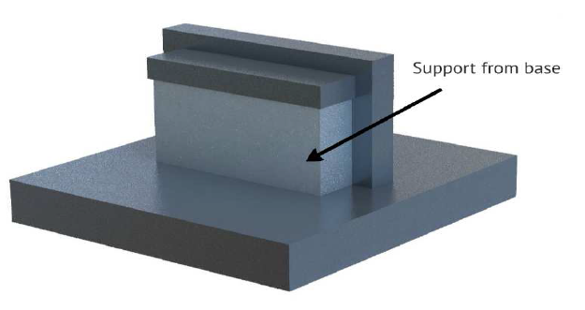
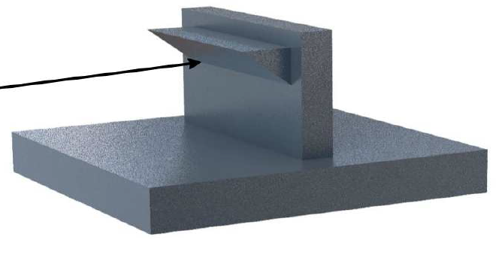
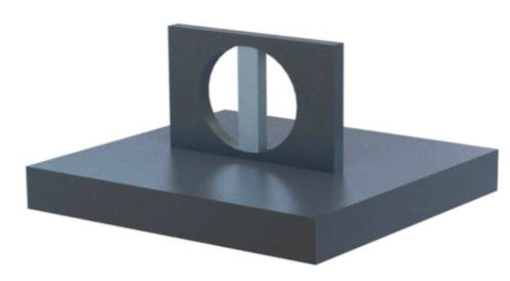
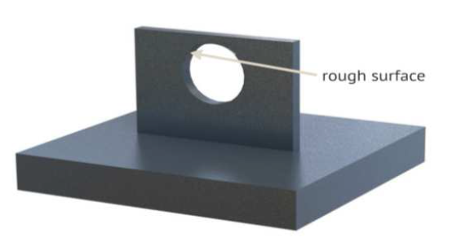
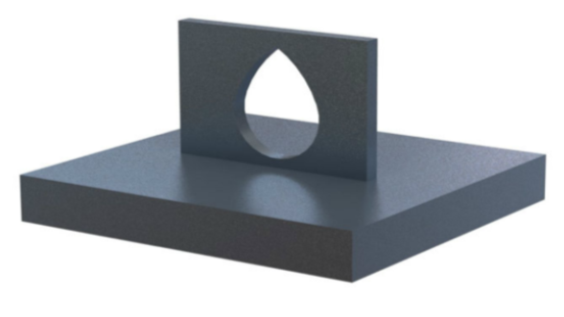
Additive Manufacturing
Short introduction to the technology
Supports
Holes

Slide 4
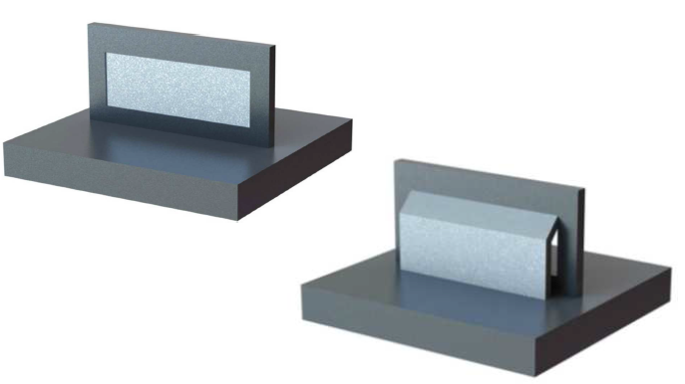
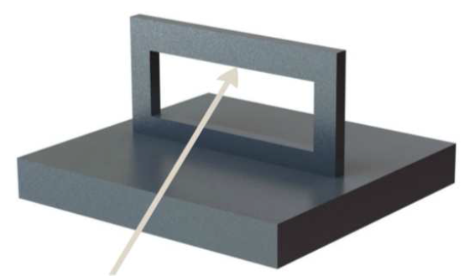
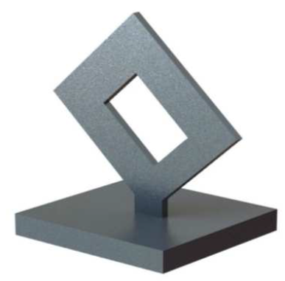
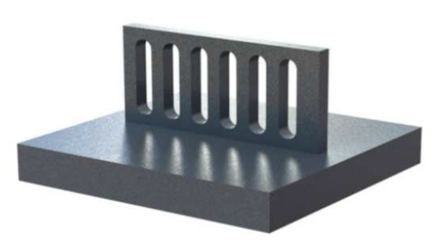
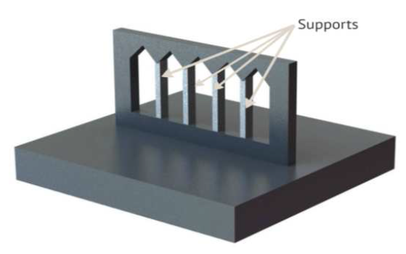
Additive Manufacturing
Short introduction to the technology
Down Ward Facing Surfaces

Slide 5
Additive Manufacturing
PROCESSES

Slide 6
Additive Manufacturing
Major AM processes classification
Stereolithography
Jetting Systems
Direct Light Processing
Liquid Based
Selective Laser Sintering
Three-Dimensional Printing
Fused Metal Deposite Systems
Electron Beam Melting
Selective Laser Melting
Selective Masking Sintering
Selective Inhibition Sintering
Electro photographic Layered
Manufacturing
High Speed Sintering
AM Processes
Powder Based
Solid Based
Fused Deposition Modelling
Sheet Stacking Technologies

Slide 7
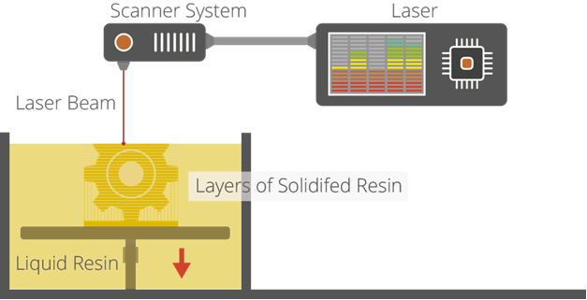
Additive Manufacturing
Stereolithography (SL)
is widely recognized as the ﬁrst 3D printing process;
it was certainly the ﬁrst to be commercialised. SL is a
laser-based process that works with photopolymer
resins, that react with the laser and cure to form a
solid in a very precise way to produce very accurate
parts.
It is a complex process, but simply put, the photopolymer
resin is held in a vat with a movable platform inside. A laser beam is directed in the X-Y axes across the surface of the resin according to the 3D data supplied to the machine (the .stl ﬁle), whereby the resin hardens precisely where the laser hits the surface. Once the layer is completed, the platform within the vat drops down by a fraction (in the Z axis) and the subsequent layer is traced out by the laser. This continues until the entire object is completed and the platform can be raised out of the vat for removal.
Because of the nature of the SL process, it requires support structures for some parts, speciﬁcally those with overhangs or undercuts. These structures need to be manually removed. In terms of other post processing steps, many objects 3D printed using SL need to be cleaned and cured. Curing involves subjecting the part to intense light in an oven-like machine to fully harden the resin. Stereolithography is generally accepted as being one of the most accurate 3D printing processes with excellent surface ﬁnish.
However limiting factors include the post-processing steps required and the stability of the materials over
time, which can become more brittle.

Slide 8
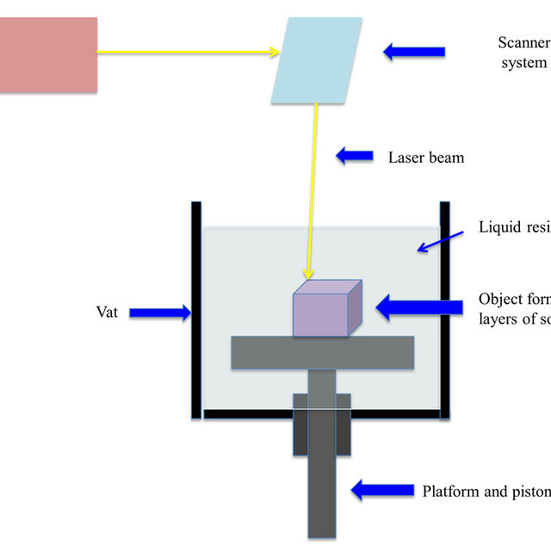
Additive Manufacturing - SLA

Slide 9
Adv & disadv, applns
Advantages of SLA.
Relatively fast production.
Good for complex models.
Scalability is simple.
No Human factor.
No Wasted Materials.
Biomedical Molding Application.
Disadv
Depending on the material, components may be brittle.
Support structures can limit design freedom.
Components are only UV-resistant to a limited extent.
Applications
stereolithography for medical device design, among many other industries, a vital process for creating models and prototypes that help refine and prove designs

Slide 10
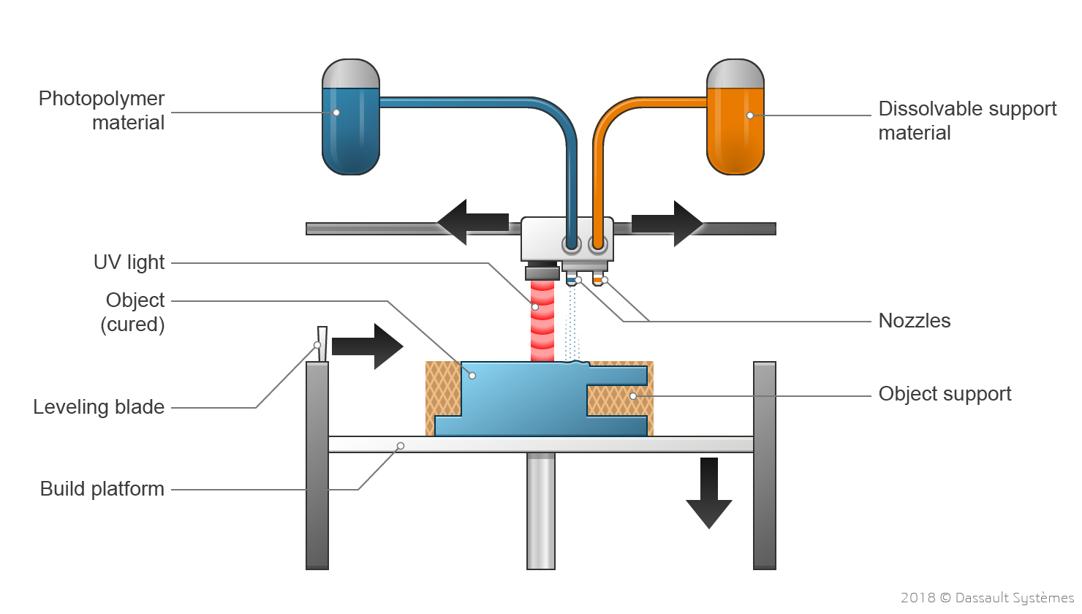
Additive Manufacturing – Jetting systems
Material jetting creates objects in a similar method to a two dimensional ink jet printer. Material is jetted onto a build platform using either a continuous or Drop on Demand (DOD) approach.
PolyJet printers have print heads, build chamber, material container and UV Curing light
Liquid resin inside the container is heated at the start to achieve optimum viscosity suitable for jetting
Print head jets thousands of tiny droplets of photopolymer as per the layer information, travelling across the X-Y build platform
UV light cures the material deposited and solidifying it to create the layer
Once the layer is completed the build platform is moved downwards to start the next layer
This process continues until the part has finished printing

Slide 11
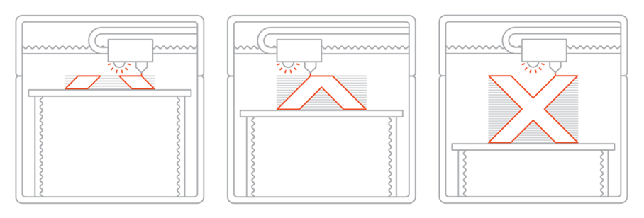
Additive Manufacturing – Jetting systems

Slide 12
Adv & disadv, applns
Advantages
The metal particles being jetted are nanoscale and the resulting layer thickness is extremely thin as compared to other additive technologies.
Ultra-thin layers produce very high-resolution parts where the layers are nearly invisible to the human eye.
Disadv
Production cost is high due to slow build process– With the use of techniques other than additive manufacturing, parts can be made faster and hence the extra time can lead to higher costs.
Besides high-quality of additive manufacturing machines may cost high.
Applications
rapid prototyping for design verification to building functional parts and tooling

Slide 13
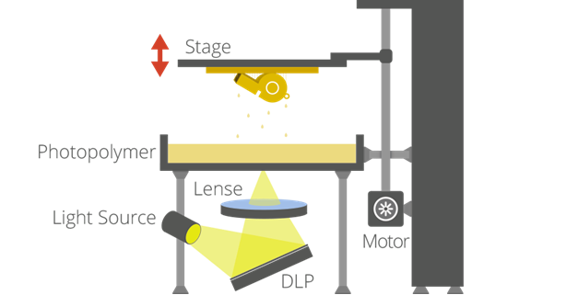
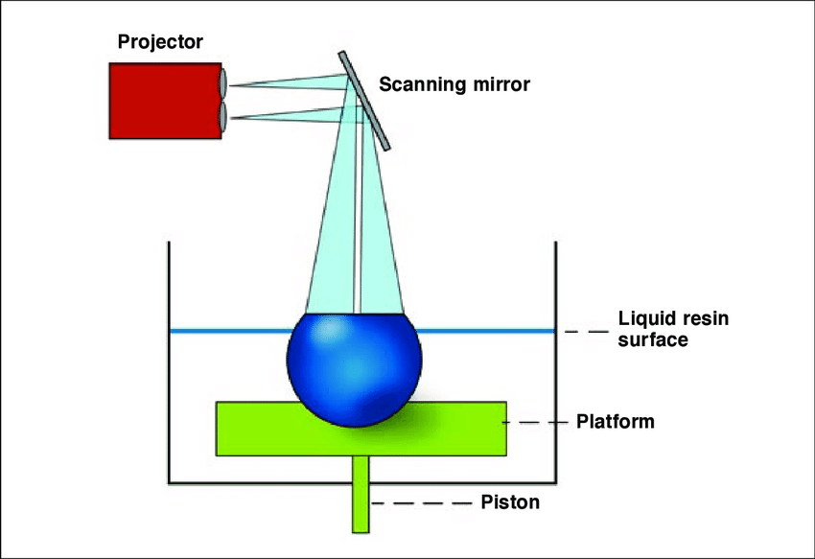
Additive Manufacturing
Digital Light Processing (DLP)
is a similar process to Stereolithography in that it is a 3D printing process that works with photopolymers. The major diﬀerence is the light source. DLP uses a more conventional light source, such as an arc lamp, with a liquid crystal display panel or a deformable mirror device (DMD), which is applied to the entire surface of the vat of photopolymer resin in a single pass, generally making it faster than SL.
Also like SL, DLP produces highly accurate parts with excellent resolution, but its similarities also include the same requirements for support structures and post-curing. However, one advantage of DLP over SL is that only a shallow vat of resin is required to facilitate the process, which generally results in less waste and lower running costs.

Slide 14
Advantages of DLP Very intricate designs — more accurate than FDM or SLS. Fast — almost always faster than SLA printing. Less running costs than SLA as usually uses a shallower resin vat, reducing waste.
Limitations of stereolithography
Stereolithography uses equivalent materials which are resins. ...
Expensive machines: if we had predicted the boom in 3D printing in the past few years, experts have neglected the cost of the machines and the difficulty of their operation.
Applications
Several applications use DLP technology including projectors, movie projectors, cell phones, and 3D printing.

Slide 15
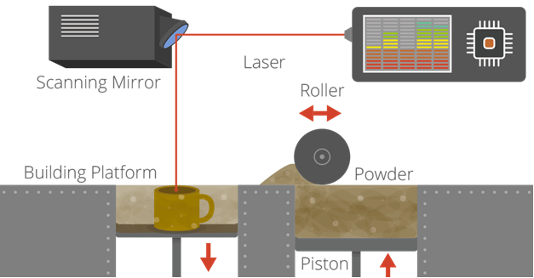
Additive Manufacturing
Laser sintering and laser melting (SL, SLM)
are interchangeable terms that refer to a laser based
3D Printing process that works with powdered
materials.
The laser is traced across a powder bed of tightly
Compacted powdered material, according to the
3D data fed to the machine, in the X-Y axes.
As the laser interacts with the surface of the
powdered material it sinters, or fuses, the particles
to each other forming a solid. As each layer is
completed the powder bed drops incrementally and a roller smoothes the powder over the surface of the bed prior to the next pass of the laser for the subsequent layer to be formed and fused with the previous layer.
The build chamber is completely sealed as it is necessary to maintain a precise temperature during the process speciﬁc to the melting point of the powdered material of choice. Once ﬁnished, the entire powder bed is removed from the machine and the excess powder can be removed to leave the ‘printed’ parts. One of the key advantages of this process is that the powder bed serves as an in-process support structure for overhangs and undercuts, and therefore complex shapes that could not be manufactured in any other way are possible with this process.

Slide 16
Additive Manufacturing
Laser sintering and laser melting (SL, SLM)
However, on the downside, because of the high temperatures required for laser sintering, cooling times can be considerable. Furthermore, porosity has been an historical issue with this process, and while there have been signiﬁcant improvements towards fully dense parts, some applications still necessitate inﬁltration with another material to improve mechanical characteristics.
Laser sintering can process plastic and metal materials, although metal sintering does require a much higher powered laser and higher in-process temperatures. Parts produced with this process are much stronger than with SL or DLP, although generally the surface ﬁnish and accuracy is not as good.

Slide 17
Advantages
Best for producing strong, functional parts with complex geometries.
High level of accuracy (though not as high as stereolithography).
Doesn’t require supports, saving printing and post-processing time.
Disadvantages / Limitations
Very expensive. The machines cost and material is high
The machines required skilled operators to use.
Cool-down time of 50% of print time can mean up to 12 hours of waiting. This leads to longer production time.
Parts have a grainy surface without any post-processing.
Applications
Its most common application is in prototype parts early in the design cycle such as for investment casting patterns, automotive hardware, and wind tunnel models. SLS is also increasingly being used in limited-run manufacturing to produce end-use parts for aerospace, military, medical, and electronics hardware.

Slide 18
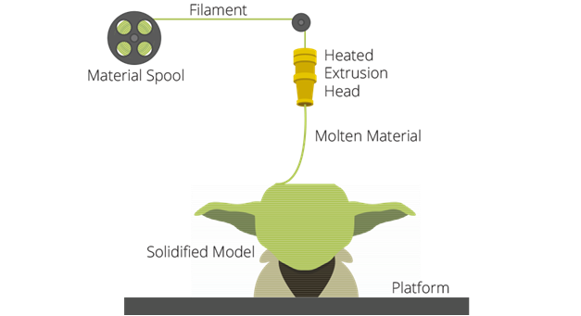
Additive Manufacturing
Fused Deposition Modelling FDM & Freeform Fabrication FFF
The thermoplastics are liquefied and deposited by an extrusion head, which follows a tool-path defined by the CAD file. The materials are deposited in layers as fine as 0.04 mm (0.0016") thick, and the part is built from the bottom up – one layer at a time. FDM works on an "additive" principle by laying down material in layers. A plastic filament or metal wire is unwound from a coil and supplies material to an extrusion nozzle which can turn the flow on and off. The nozzle is heated to melt the material and can be moved in both horizontal and vertical directions by a numerically controlled mechanism, directly controlled by a computer-aided manufacturing(CAM) software package. The model or part is produced by extruding small beads of thermoplastic material to form layers as the material hardens immediately after extrusion from the nozzle. Stepper motors or servo motor are typically employed to move the extrusion head.
The process works by melting plastic ﬁlament that is deposited, via a heated extruder, a layer at a time, onto a build platform according to the 3D data supplied to the printer. Each layer hardens as it is deposited and bonds to the previous layer.

Slide 19
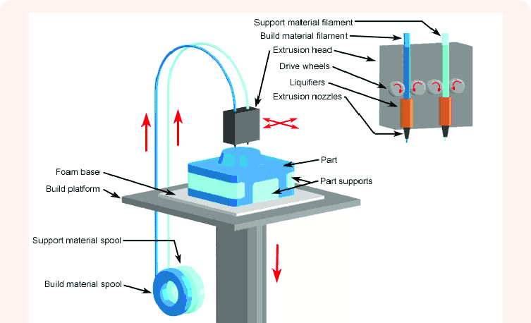
Additive Manufacturing

Slide 20
Advantages
Wide variety of materials: ABS, ABS / PC, PC, PLA, PET, PA, materials mixed with fibers, with high performance
Ease of removing media
Absence of post curation
Possibility of manufacturing very large pieces without deformations
Possibility of combining materials during manufacturing
Disadvantages / Limitations
Despite all the 3D printing achievements made possible through FDM, it has its limitations.
you can replicate, difficulties 3D printing finely-detailed items, and finished product quality issues.
Applications
Models for dimensional and functional validation of product
Parts with approved material for aeronautics
Possibility of chromating ABS parts
Manufacture of short series (low volume manufacturing) of pieces
Manufacture of lower cost parts

Slide 21
Additive Manufacturing
Laminated object manufacturing (LOM)
is a rapid prototyping system developed by Helisys Inc.
In it, layers of adhesive-coated paper, plastic, or metal
laminates are successively glued together and cut to shape
with a knife or laser cutter. Objects printed with this
technique may be additionally modified by machining or
drilling after printing.
Typical layer resolution for this process is defined by the
material feedstock and usually ranges in thickness from
one to a few sheets of copy paper.
Laminated object manufacturing is a lesser known additive manufacturing process where an object iscreated by successively layering sheets of build material, bonding them through heat and pressure and then cutting them into the desired shape using either a blade or a carbon laser.
layers of adhesive-coated paper, plastic, or metal laminates are successively glued together

Slide 22
Additive Manufacturing
Laminated object manufacturing (LOM)
Advantages of sheet lamination
Relatively low cost
Larger working area
Full-color prints
Integrates as hybrid manufacturing systems
Ease of material handling
Ability to layer multiple materials
No support structures needed
In some sheet lamination
Depending on technique type used, the material state remains unchanged
Faster print time, but does require post-processing
Disadvantages of sheet lamination
Layer height can’t be changed without changing the sheet thickness
Finishes can vary depending on the material and could require post-processing
Limited material options available
Removal of excess material after the laminating phase can be difficult and time-consuming
Can generate more waste in comparison to other AM methods
Hollow parts are challenging to produce in some types of sheet lamination
Bonding strength is dependent on the laminating technique used

Slide 23
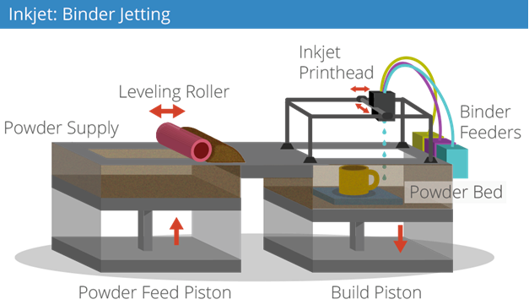
Additive Manufacturing
Binder Jetting
There are two 3D printing process that utilize a jetting technique.
Binder jetting: where the material being jetted is a binder,
and is selectively sprayed into a powder bed of the part material
to fuse it a layer at a time to create/print the required part.
As is the case with other powder bed systems, once a layer is
completed, the powder bed drops incrementally and a roller or
blade smoothes the powder over the surface of the bed, prior to
the next pass of the jet heads, with the binder for the subsequent layer to be formed and fused with the previous layer.
Advantages of this process, like with SLS, include the fact that the
need for supports is negated because the powder bed itself provides this functionality. Furthermore, a range of diﬀerent materials can be used, including ceramics and food. A further distinctive advantage of the process is the ability to easily add a full colour palette which can be added to the binder.
The parts resulting directly from the machine, however, are not as strong as with the sintering process and require post-processing to ensure durability.

Slide 24
Additive Manufacturing
Binder Jetting
Advantages of Binder Jetting
Ability to make parts with a range of different colors
Uses a range of materials: metal, polymers, and ceramics
Faster AM process
No warping or shrinking of parts
Less waste by reusing any unused powder
Features a two-material method that allows different binder-powder combinations
Disadvantages of Binder Jetting
Parts require post-processing which adds significant time to the overall process
Low part strength, not always suitable for structural parts
Less accurate then Material Jetting
.

Slide 25
Additive Manufacturing
Electron beam Melting
The build plate is coated with a layer of metal powder.
As the layer is preheated, the powerful electron beam selectively melts powder in the areas defined by the digital CAD model.
The next layer is then deposited and the beam melts and fuses layers together.
The process is repeated until the final shape of a part is achieved. After removing the excess powder, the metal part can then undergo post processing. To prevent contamination and oxidation of the powder, the printing process takes place in a vacuum environment.
.

Slide 26
Additive Manufacturing
Advantages of EBM
EBM offers a number of benefits that distinguish it from other metal AM technologies.
The EBM process uses a beam several times more powerful than a laser EBM can produce high-quality metal parts comparable to those produced with traditional manufacturing methods such as casting.
Not only do the parts possess strong mechanical properties, they also typically have a high density (over 99
Preheating the print bed also minimises residual stresses, a common issue faced with metal 3D printing, reducing the need for support structures.
EBM offers minimal waste, as most of the unused powder can be recycled for future use – a particular benefit considering the substantial costs of the materials used in EBM.
Limitations of EBM
On the other hand, EBM parts typically have a lower level of accuracy
Thicker layers can often result in a rough surface finish, and EBM parts require extensive additional post-processing to achieve a smoother surface.
The cost of materials along with the cost of EBM 3D printers make this technology an expensive option, suitable only for industrial applications.
Notes:
— the main heat source used in other metal 3D printing technologies. This increased beam power — multiple electron beams are used simultaneously in the EBM process — ultimately means faster printing speeds.

Slide 27
Additive Manufacturing
Common applications
The most common applications for EBM technology can be found in the medical and aerospace industries, as the technology offers an effective way of producing lightweight, complex parts.
Within the medical industry, EBM can be used to produce implants and other medical implants, customised to suit the patient’s requirements.
In aerospace industry, EBM is particularly useful for producing aerospace components with a substantial weight reduction.
GE, for example, is already using EBM technology to 3D print turbine blades for jet engines.
.
Notes:
— the main heat source used in other metal 3D printing technologies. This increased beam power — multiple electron beams are used simultaneously in the EBM process — ultimately means faster printing speeds.
Materials
A limited range of metals can be used with EBM, including with titanium alloys (ideal for medical implants), cobalt chrome, steel powders, and nickel alloy 718. These materials demonstrate high strength, resistance to corrosion and top mechanical properties.
It is important to note that any material used in EBM must be conductive, as the process heavily relies on electrical charges.
EBM is also reportedly the only commercial AM solution for manufacturing titanium aluminide (TiAl) parts. TiAl is particularly noted for its light weight, strength and heat resistance, although it is prone to cracking.

Slide 28
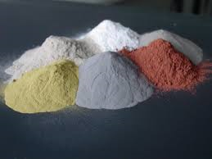
Additive Manufacturing
MATERIALS

Slide 29
Additive Manufacturing
AM Materials
However, there are now way too many proprietary materials from the many diﬀerent 3D printer vendors to cover them all here.
Instead, we will look at the most popular types of material in a more generic way. And also a couple of materials that stand out.
Liquid Based
Powder Based
Solid Based

Slide 30
Additive Manufacturing
Short introduction to the technology
AM Materials
Nylon, or Polyamide, is commonly used in powder form with the sintering process or in ﬁlament form with the FDM process. It is a strong, ﬂexible and durable plastic material that has proved reliable for 3D printing. It is naturally white in colour but it can be coloured — pre- or post printing. This material can also be combined (in powder format) with powdered aluminium to produce another common 3D printing material for sintering Alumide.
ABS is another common plastic used for 3D printing, and is widely used on the entry-level FDM 3D printers in ﬁlament form. It is a particularly strong plastic and comes in a wide range of colours.
ABS can be bought in ﬁlament form from a number of non- propreitary sources, which is another reason why it is so popular.
PLA is a bio-degradable plastic material that has gained traction with 3D printing for this very reason. It can be utilized in resin format for DLP/SL processes as well as in ﬁlament form for the FDM process. It is oﬀered in a variety of colours, including transparent, which has proven to be a useful option for some
some applications of 3D printing. However it is not as durable oras ﬂexible as ABS.

Slide 31
Additive Manufacturing
AM Materials
LayWood is a specially developed 3D printing material for entry- level extrusion 3D printers. It comes in ﬁlament form and is a wood/polymer composite (also referred to as WPC).
A growing number of metals and metal composites are used for industrial grade 3D printing. Two of the most common are aluminium and cobalt derivatives.
One of the strongest and therefore most commonly used metals for 3D printing is Stainless Steel in powder form for the sintering/ melting/EBM processes. It is naturally silver, but can be plated with other materials to give a gold or bronze eﬀect.
In the last couple of years Gold and Silver have been added to the range of metal materials that can be 3D printed directly, with obvious applications across the jewellery sector. These are both very strong materials and are processed in powder form.
Titanium is one of the strongest possible metal materials and has been used for 3D printing industrial applications for some time.
Supplied in powder form, it can be used for the sintering/melting/ EBM processes.

Slide 32
Additive Manufacturing
AM Materials
Ceramics
Ceramics are a relatively new group of materials that can be used for 3D printing with various levels of success. The particular thing to note with these materials is that, post printing, the ceramic parts need to undergo the same processes as any ceramic part made using traditional methods of production - namely ﬁring and glazing.
Paper
Standard A4 copier paper is a 3D printing material employed by the proprietary SDL process supplied by Mcor Technologies. The company operates a notably diﬀerent business model to other 3D printing vendors, whereby the capital outlay for the machine is in the mid-range, but the emphasis is very much on an easily obtainable, cost-eﬀective material supply, that can be bought locally. 3D printed models made with paper are safe, environmentally friendly, easily recyclable and require no post-processing.
Bio Materials
There is a huge amount of research being conducted into the potential of 3D printing bio materials for a host of medical (and other) applications. Living tissue is being investigated at a number of leading institutions with a view to developing applications that include printing human organs for transplant, as well as external tissues for replacement body parts. Other research in this area is focused on developing food stuﬀs - meat being the prime example.

Slide 33
Additive Manufacturing
AM Materials
Bio Materials
There is a huge amount of research being conducted into the potential of 3D printing bio materials for a host of medical (and other) applications. Living tissue is being investigated at a number of leading institutions with a view to developing applications that include printing human organs for transplant, as well as external tissues for replacement body parts.
Food
Experiments with extruders for 3D printing food substances has increased dramatically over the last couple of years. Chocolate is the most common (and desirable). There are also printers that work with sugar and some experiments with pasta and meat. Looking to the future, research is being undertaken, to utilize 3D printing technology to produce ﬁnely balanced whole meals.
Other
And ﬁnally, one company that does have a unique (proprietary) material oﬀering is Stratasys, with its digital materials for the Objet Connex 3D printing platform. This oﬀering means that standard Objet 3D printing materials can be combined during the printing process — in various and speciﬁed concentrations to form new materials with the required properties. Up to 140 diﬀerent Digital Materials can be realized from combining the existing primary materials in diﬀerent ways.

Slide 34
Additive Manufacturing
Safety features
Powder handling & changing - The following risks may be experienced while working with the systems:
Risk or damage to respiratory tract and lungs when handling metal powders and filter dust and suspected carcinogenic effect of the metal powder and filter dust. It is strongly recommended to wear breathing protection (respiratory mask; particle filter P2D or P3D) and NEVER inhale the dust when filling, emptying and cleaning the build envelope (build module, dosing chamber, coater, powder overflow) and when emptying the collecting container and filter cartridge of the extraction and filter unit.
Risk of eye damage when handling metal powder and filter dust. It is strongly recommended to wear eye protection (close-fitting safety goggles) when filling, emptying and cleaning the build envelope (build module, dosing chamber, coater, powder overflow) and when emptying the collecting container and filter cartridge of the extraction and filter unit.
Risk of compressed air outlet. Compressed air can escape if compressed air lines and union joints are opened or damaged. It is strongly recommended to wear safety gloves due to risk of skin damage. The toxic nickel in the metal powder and filter dust can cause irreversible damage or a sensitisation through skin contact (allergic reaction).
Risk of suspected carcinogenic effect of the metal powder and filter dust. A longer period inhaling of powder dust may cause accumulation of powder in lungs, blood and other organs which has a strong carcinogenic effect.
Laser system
The principal risks of the laser system are the following:
Laser is “invisible” (Class 1). This means that the human eye cannot detect the beam if it impacts the eye. It is highly recommended to activate the laser only when the door is closed due to protective action of the door crystal.
Special precaution should be made with docking/undocking of the build chamber. The laser may impact with the part and suffer severe damage.

Slide 35
Additive Manufacturing
3D printers are energy hogs
When melting plastic with heat or lasers, 3D printers consume about 50 to 100 times more electrical energy than injection molding to make an item of the same weight, according to research by Loughborough University. In 2009, research at MIT's Environmentally Benign Manufacturing program showed that laser direct metal deposition (where metal powder is fused together) used hundreds of times the electricity as traditional casting or machining. Because of this, 3D printers are better for small batch runs. Industrial-sized 3D printers may not be the answer to lessening our use of coal power any time soon.
Unhealthy air emissions
3D printers may pose a health risk when used in the home, according to researchers at the Illinois Institute of Technology. The emissions from desktop 3D printers are similar to burning a cigarette or cooking on a gas or electric stove. The 2013 study was the first to measure these airborne particle emissions from desktop 3D printers. While heating the plastic and printing small figures, the machines using PLA filament emitted 20 billion ultrafine particles per minute, and the ABS emitted up to 200 billion particles per minute. These particles can settle in the lungs or the bloodstream and pose health risk, especially for those with asthma.
Reliance on plastics
One of the biggest environmental movements in recent history has been to reduce reliance on plastics, from grocery bags to water bottles to household objects that can be made from recycled materials instead. The most popular—and cheapest—3D printers use plastic filament. Though using raw materials reduces the amount of waste in general, the machines still leave unused or excess plastic in the print beds. PLA is biodegradable, but ABS filament is still the most commonly used type of plastic. The plastic byproduct ends up in landfills. If 3D printing is going to be industrialized, that byproduct or other recycled plastic needs to be reused.

Slide 36
Additive Manufacturing
IP and licensing deals
3D printing will change the business market—and the black market for these items—and the legislation will have to rush to catch up. This potential digital piracy situation is comparable to the way the internet challenged the movie and music industries for copyrights, trademarks, and illegal downloads.
Gun control loopholes
The first successful 3D printed gun is old news, but its ramifications are very important. Companies are popping up around the world, attempting to sell these guns and/or the CAD designs for them. Engineering firm Solid Concepts has even fired rounds out of the first 3D printed metal gun. Congress' Undetectable Firearms Act, which bans guns that can't be detected by metal detectors or x-ray scanners, was renewed for 10 years. It left a loophole in the law, however: 3D printed guns with a tiny piece of metal aren't banned by the Act. Legislators are attempting to close that loophole now, after Congress ignored the issue for quite some time, with special requirements for printed guns.
Responsibility of manufacturers
Weapons can be 3D printed. So can safety equipment such as helmets, wheels for bikes, and toys for small children. Of course there is the issue of intellectual property and trademark, but the larger issue involves responsibility. If a person shoots a gun and harms or kills someone, stabs someone with a 3D printed knife, or breaks their neck while riding on a bike with a 3D printed helmet, who is held accountable? The owner of the printer, the manufacturer of the printer, or the irresponsible person who thought it was a good idea to produce and use an untested product?

Slide 37
Additive Manufacturing
Bioprinting ethics and regulation
Cornell bioengineers and physicians created an artificial ear that looks and acts like a natural one.
The conversations about the ethics of bioprinting have already begun. Organovo is printing liver cells as well as eye tissue cells in a partnership with the National Eye Institute and National Center for Advancing Translational Sciences. Scientists have also proposed mixing human stem cells with canine muscle cells to create enhanced organ tissue. Printing cartilage is still the most realistic type of bioprinting, and printing whole organs is still many years away, but 3D printing is growing in medicine quite rapidly. Conversations about the moral, ethical, and legal issues surrounding bioprinting have started, but they will inevitably cause a lot more controversy as it becomes more commonplace.
Possibility of 3D printed drugs
Assembling chemical compounds on a molecular level using a 3D printer is possible. A researcher at the University of Glasglow created a prototype of a 3D "Chemputer" that makes drugs and medicine. He wants to revolutionize the pharmaceutical industry by allowing patients to print their own medicine with a chemical blueprint they get from the pharmacy. Of course, this is a very long way off, but it stands to enable DIY chemists to create anything from cocaine to ricin.
Safety of items that come into contact with food
Kitchenware is popular to 3D print, but the safety of the materials used is questionable.
You can print out a fork or spoon with your MakerBot, but if you use ABS plastic, it is not BPA-free. Luckily, new filaments that are safer to put in your mouth are being created for this specific reason, but they aren't widely available yet. Many 3D printers have spaces where bacteria can easily grow if they aren't cleaned properly, as well. In order to more safely-produced 3D printed food and kitchenware, there may be a need for an FDA-approved machine. People probably don't want to eat genetically-engineered pizza off of toxic plates.

Slide 38
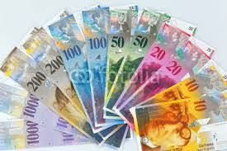
Additive Manufacturing
Some commercial aspects

Slide 39
Additive Manufacturing
The costs of RM Fabrication depends basically on:
Part fabrication costs
The costs of RM parts depends on these parameters:
- Volume of the part.
- Cost of materials.
- Cost of consumables.
- Height of the part.
- Height of supports
- Number of slices
Man Power
0,1-0,5 FTE
Space requirements
Approx. 25-30m2 for the machine, container, generator stocking room
Auxiliary equipment ( temporary )
Electro erosion, milling machine and compressed air

Slide 40
Additive Manufacturing
Peripherals & Consumable
Powder materials
Lifting and transportation device for material handling
Build platform ( first set is delivered with the order)
Cleaning and handling: hand sieves , brush, gloves filter mask shovel….
Recoaster blades
Antistatic waste bags
Maintenance
Software maintenance
Machine maintenance

Slide 41
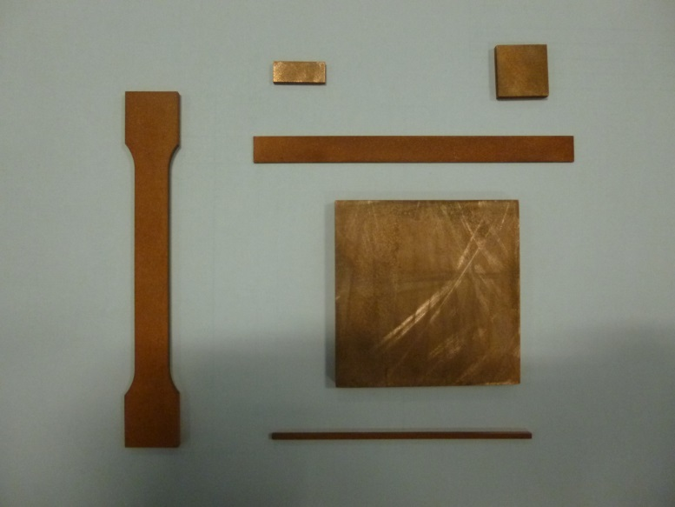
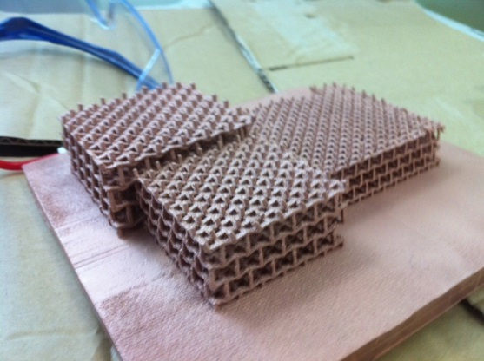
Additive Manufacturing
:
Printing models in some polymer materials Subcontracting parts in polymer
Subcontracting parts in metal
Exploring ceramic materials
Exploring the installation of an 3D metal printer
Several collaboration agreements in 3D printing
R&D to print pure Copper and Niobium

